Slide 1
Edinburgh Data Science Training for Healthcare & Biosciences
Introduction to Bioinformatics Workflows with Nextflow and nf-core
Getting Started with Nextflow

Slide 2
Ed-DaSH Training Programme
Objective: to develop and deliver data science training using The Carpentries methodology.
Topics:
Computational workflows: Unix, Conda, Nextflow/Snakemake (4 days)
Open science, FAIR principles, and data management:
Hands on Open Science, FAIR principles, and data management(2 days)
Reshaping research: How adopting FAIR increase productivity (1 day, targeted at research leaders)
Statistics:
Basic and intermediate statistical skills (2 days)*
High dimensional statistics (2 days)
Machine learning (2 days)*
*Developed by other Software Sustainability Institute funded teams

Slide 3
The Carpentries project comprises the Software Carpentry, Data Carpentry, and Library Carpentry communities of Instructors, Trainers, Maintainers, helpers, and supporters who share a mission to teach foundational computational and data science skills to researchers.

Slide 4
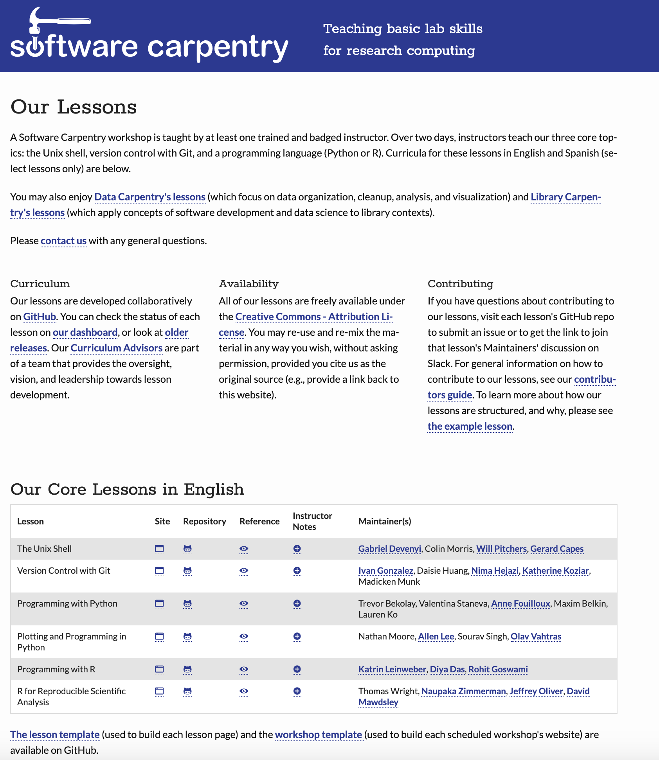

Slide 5
Bioinformatic Workflows
Getting Started with Nextflow

Slide 6
What is a Workflow?
A sequence of tasks that processes a set of data.
Streamlining Data-Intensive Biology With Workflow Systems https://doi.org/10.1101/2020.06.30.178673

Slide 7
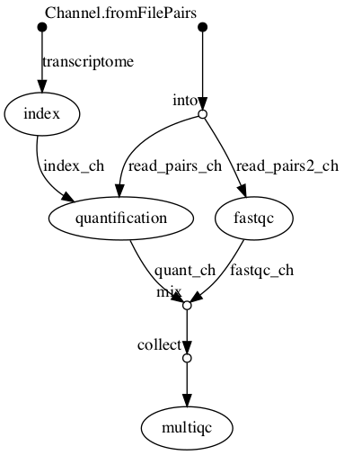
What is a workflow
Simple RNA-Seq pipeline

Slide 8
What is a workflow
Simple RNA-Seq pipeline
Complex genome Assembly pipeline
https://twitter.com/odiogosilva/status/98738600748507546
Notes:
https://twitter.com/odiogosilva/status/987386007485075461

Slide 9
What is a Workflow Management Systems WfMS?
Bioinformatic WfMS
Galaxy (2010)
Snakemake (2012)
Nextflow (2013)

Slide 10
WfMS: Key Features
Run time management
Software management
Portability & Interoperability
Reproducibility

Slide 11
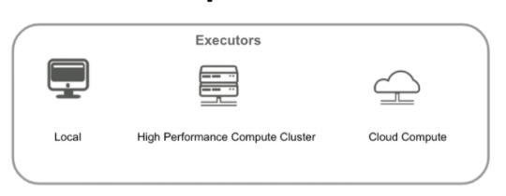
What is Nextflow?
Nextflow script
Write code in any language
Define software
dependencies with
containers
Data|flow
Define orchestration with dataflow programming
Version Control
Nextflow runtime
Orchestration of tasks to
Deploy anywhere with ease

Slide 12
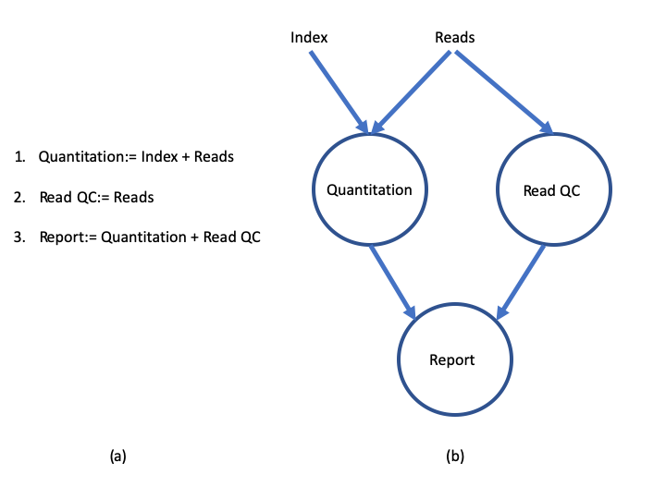
What is Dataflow Programming?

Slide 13
What are Nextflow’s core features
Fast prototyping
Reproducibility
Portable
Simple parallelisation:
Continuous checkpoints

Slide 14
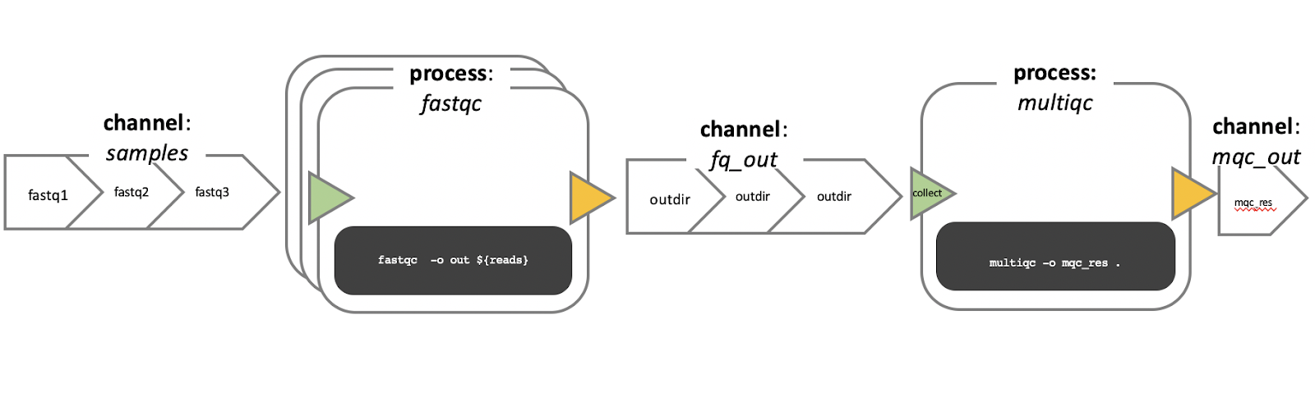
Nextflow: Processes and Channels
Notes:
Nextflow processes define what is run

Slide 15
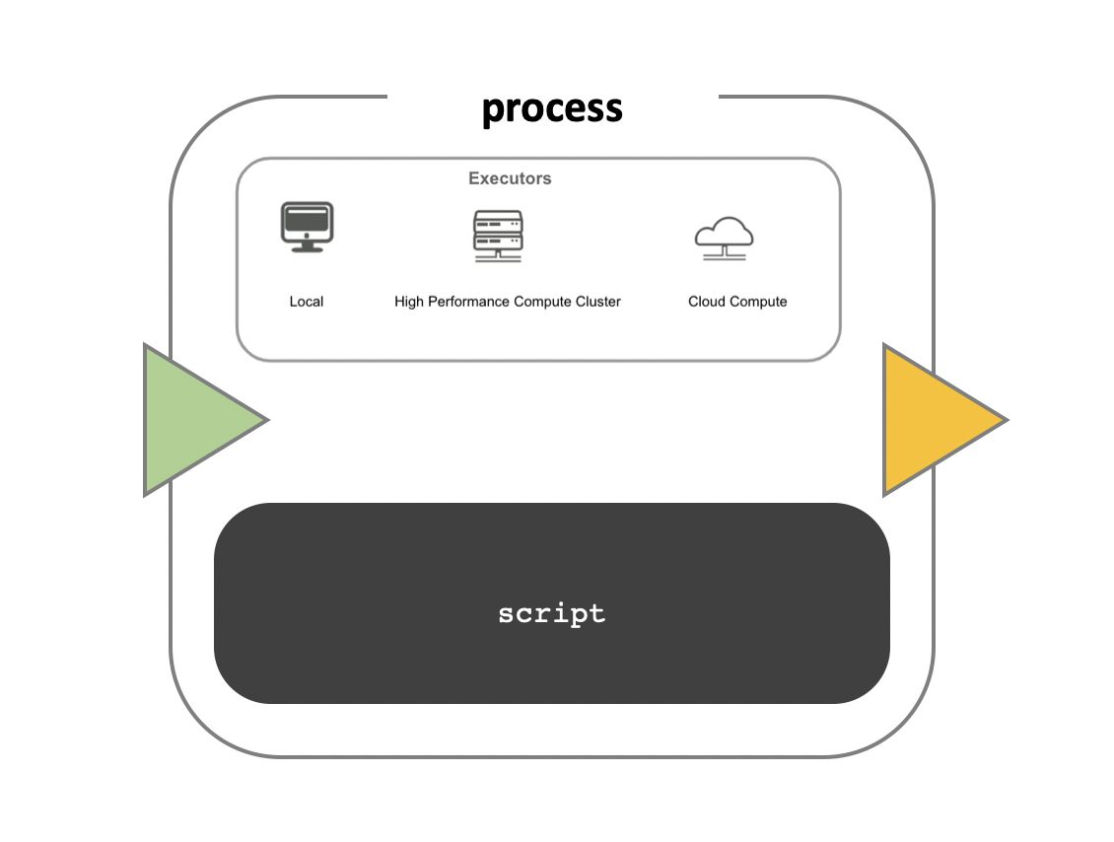
Nextflow: Workflow Execution
Notes:
Netxflow execution is where something is run.

Slide 16
Nextflow scripts
Notes:
Nextflow scripts are are the “how” a pipeline is run

Slide 17
Acknowledgements
Co-Investigators
Alison Meynert, MRC Human Genetics Unit
Alex Twyford, School of Biological Sciences
Catalina Vallejos, MRC Human Genetics Unit
Edward Wallace, School of Biological Sciences
Programme Coordinator
Giacomo Peru, Edinburgh Parallel Computing Centre
Carpentries Development Support
Flic Anderson, School of Biological Sciences
Administrative & Finance Support
MRC Institute of Genetics and Molecular Medicine
Development teams
Computational workflows
Tim Booth, Edinburgh Genomics
Graeme Grimes, MRC Human Genetics Unit
Nathan Medd, Edinburgh Genomics
Open science, FAIR principles & data management
Andrew Millar, School of Biological Sciences
Andrew Romanowski, School of Biological Sciences
Tomasz Zielinski, School of Biological Sciences
Statistics
Ailith Ewing, MRC Human Genetics Unit
Alan O’Callaghan, MRC Human Genetics Unit
Gail Robertson, Statistical Consultancy Unit, School of Mathematics

